Slide 1
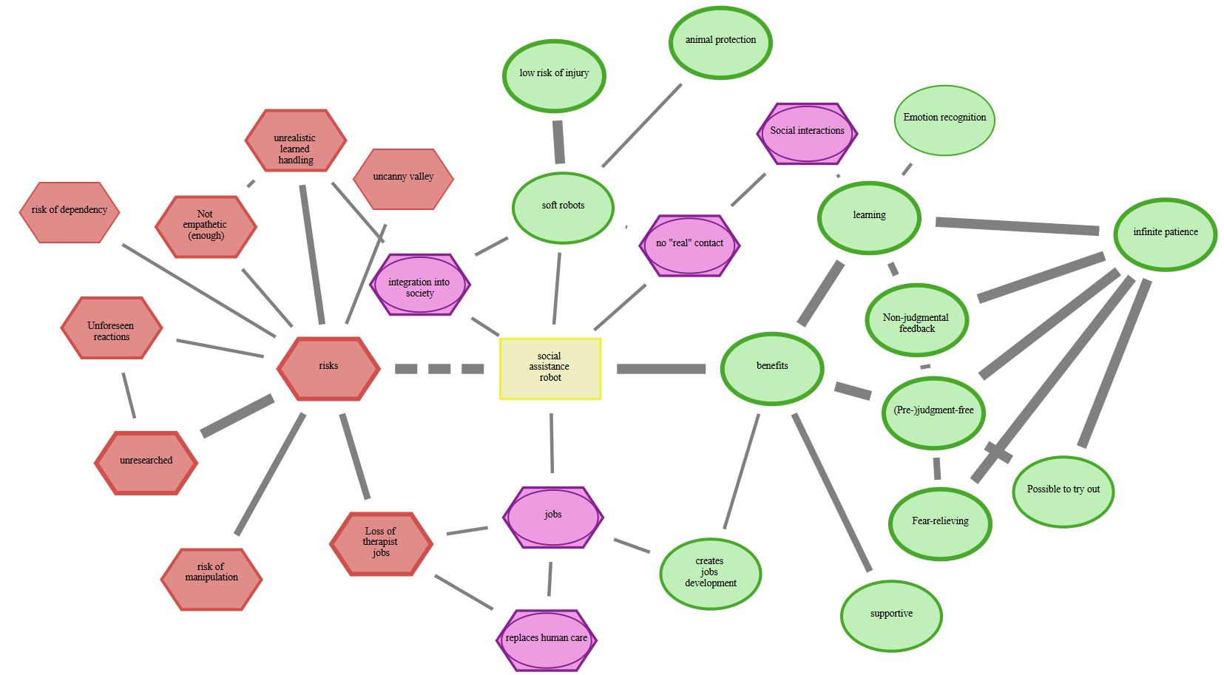
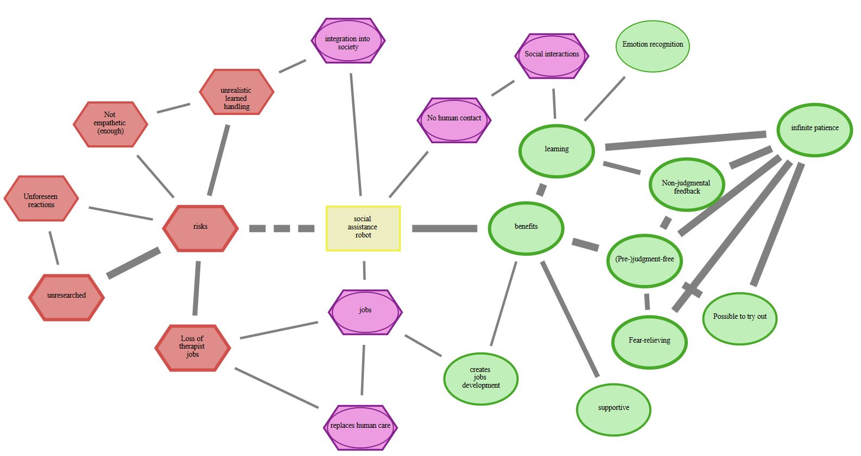


perceived risks and benefits associated with conventional (rigid) socially assistive robots
perceived risks and benefits associated with soft socially assistive robots
Low risk of injury
No human contact
Non-judgmental feedback
xxx
Loss of therapist jobs
Risk of dependency

